Slide 1
Trading at the Close
Ames Rupnick, William Friend
Eric Serbin, Adil Ansari

Slide 2
Introduction
Predicting stock market values is very important to sellers and buyers alike
10% of all trades happen at the close, making it the most popular time
Important in understanding risk management
Extremely competitive field for data analysis due to the money involved

Slide 3
What is the close?
The closing price is the final price at which a particular stock trades during a regular trading session on a given day. It is considered an important indicator because it reflects the final evaluation of a stock for that trading day.
Main reference point for comparing a stock's performance over different time periods.
used to calculate various financial metrics such as:
Simple Moving Average - measures average closing price over time
Relative Strength Index - measures speed and change of price
Weighted Average Price - avg. price weighted by share count at that price

Slide 4

Our Goal
“The Goal is to predict the future price movements of stocks relative to the future price movement of a synthetic index composed of NASDAQ-listed stocks” - Optiver
AKA, Use the closing prices to be able to understand how stocks will increase or decrease in price in the future
To do this, our measurement is Mean Squared Error (MSE):

Slide 5
Goals continued
In order to properly predict, we must:
Remove unwanted data from dataset
Add new columns to potentially shed more light onto the data
Trim all columns down for the important ones
Apply a basic machine learning model on the new dataset
Tune the model with good hyperparameters
Test the model against the validation set
Create plots and graphs to more easily understand the results

Slide 6
Our Data

Slide 7
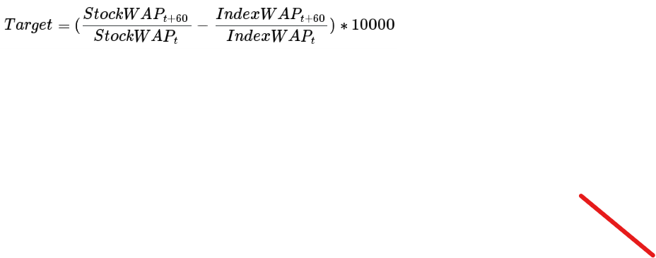
Data Explanation
The data provided by Optiver is as follows
Number of Rows: 5237980
Number of Columns: 17
One Target, called “target”, which measures the movement in the WAP (weighted average price) of the stock in units of basis points, where 1 basis point = 0.01% price move

Slide 8
Column Values
Stock_id - which stock is being referenced
Date_id - which date is the data being measured on
Seconds_in_bucket - how long the close has been occurring
Imbalance_size - amount unmatched at current reference price
Imbalance_buy_sell_flag - indicator of direction of imbalance, if +1, buy side imbalance, if -1, sell side imbalance

Slide 9

Column Values: pt. 2
Reference_price - Maximize pairs, minimize imbalance, or near price bounded between best bid and ask price
Matched_size - amount that can be matched at current reference price
Far_price - crossing price that will maximize number of shares matched based on auction interest
Near_price - crossing price that will maximize based on auction and continuous market orders
Bid price - price of most competitive buy/sell level
Bid size - the dollar notional amount on the most competitive buy/sell level in the non auction book

Slide 10

Column Values: pt. 3
ask_price - price of most competitive sell level
Ask_size - notional dollar amount of most competitive sell level in non auction book
Wap - weighted average price, as described on first slide
Target - measurement using wap now and wap in 60 seconds
time_id- api serves dataframe when 0, otherwise null
Row_id - built like date_secondsInBucket_stockId

Slide 11
DataFrame manipulation and Feature Engineering

Slide 12
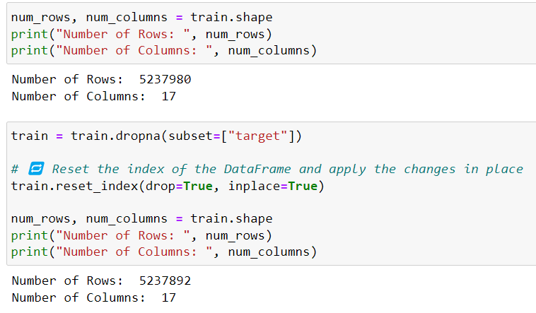
Removing incomplete entries
There are some rows in which the target is not there NaN
Essential to get rid of immediately
Reduces dataframe by 88 rows

Slide 13
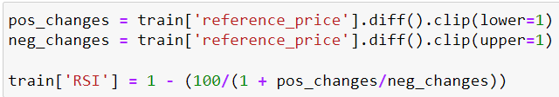
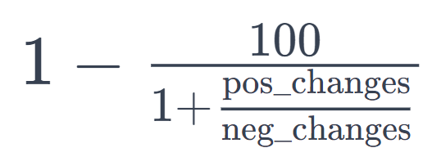
Our Feature 1: Relative Strength Index
(RSI) is a momentum oscillator that measures the speed and change of price movements.
We use formula:

Slide 14
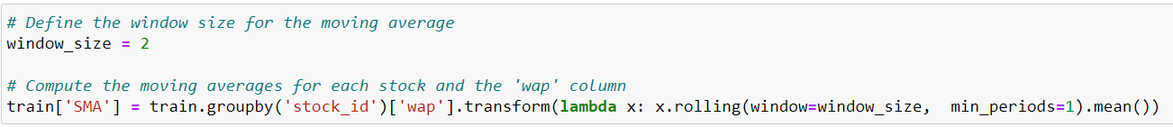

Our Feature 2: Simple Moving Average
As each new day's closing price becomes available, simple moving average includes it in the calculation and drops the oldest closing price. This creates a moving average that continuously reflects the most recent prices.
Aka, iteratively calculates the average price, including the prices only before it
Formula is:

Slide 15
Our Feature 3: Price Deviation
Price deviation allows the model to see how far the last traded price is from the reference, which explains trading is happening higher or lower than expected

Slide 16
⚡Optiver 🚀Robust Best ⚡ Single Model Features pt 1
These Features were gotten from the kaggle above
Volume is measure of both ask and bid sizes
Mid price is the price is the halfway point between ask and bid prices
Liquidity imbalance of the bid-ask spread is a common indicator of liquidity. It represents the difference between bid and ask sizes, normalized by their sum

Slide 17
⚡Optiver 🚀Robust Best ⚡ Single Model Features pt 2
Matched imbalance is difference of imbalance size and matched size normalized as well
Size imbalance refers to difference between bid and ask size
Price spread is actually how far apart the tow prices are
Market urgency is how different the prices are along with how liquid it is

Slide 18
Feature Extraction Using Catboost

Slide 19
Introduction
CatBoost is a machine learning library specifically designed for gradient boosting on decision trees
Known as CatBoost to its effectiveness at handling categorical features
Uses many weaker decision trees to build its model
Can use regression to compute loss at end of each tree, using L2 ridge regression to punish large losses to prevent overfitting
Popular for its many models, excellent cross validation, and easily interpretable models
Encoding technique and symmetrical trees makes it extremely quick compared to many other boosting techniques

Slide 20
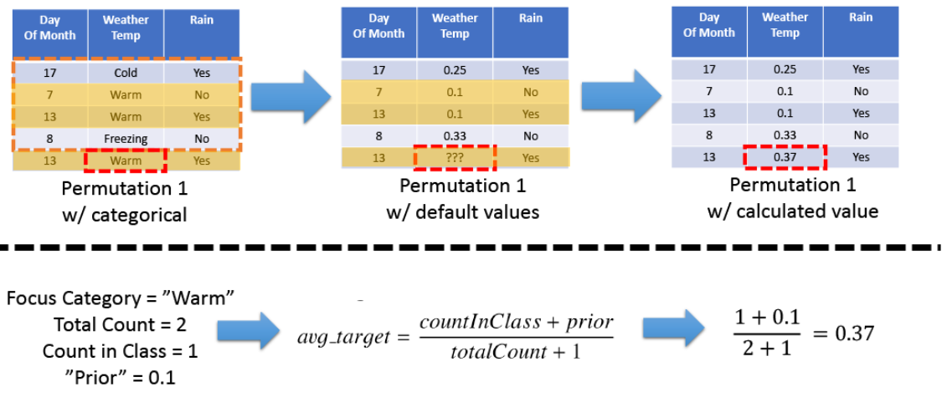
Categorical Handling
Handles categorical instead of one hot encoding by creating permutations on the shuffled dataset and assigning default values to the first few categorical features, and calculating the rest like below
avoids sparsity of one hot encoding, known as Ordered Target Encoding

Slide 21
How Permutations Affect Feature Importance
permutation feature importance is defined to be the decrease in a model score when a single feature value is randomly shuffled
If the model's performance significantly degrades after you permutate, it suggests that those features are important for the model
if the model performs similarly with or without the permuted features, it indicates that those features might be less important

Slide 22
Ensemble Technique
CatBoost starts with an initial simple model, usually a constant value representing the mean of the target variable.
Shuffles and does categorical handling
For each iteration (tree) in the boosting process, CatBoost calculates the negative gradient of the objective function with respect to the predicted values. Builds a SYMMETRICAL tree based of off the negative gradient
Each tree is added to the model to correct the model’s error
Uses shrinkage, which gradually reduces the impact of each new tree added to the ensemble to prevent overfitting
Repeats, adding more trees to the model until iterations finish or criteria is met

Slide 23
Importance of Symmetrical Trees
Only Catboost uses symmetrical trees
Avoids deep, complex trees, which slow computation
Symmetric trees also are better at generalization (handling unseen data) which helps avoid avoid overfitting

Slide 24
Model and HyperParameters

Slide 25
Hyperparameters
Tuning your hyperparameters is absolutely critical in obtaining a high-accuracy model.
The difference between a very low-accuracy model versus a high-accuracy one is sometimes as simple as tuning the hyperparameters.
Specifically, hyperparameter tuning by:
Obtaining a baseline with no hyperparameter tuning where we have a benchmark to improve
Exhaustively grid searching over a set of hyperparameters

Slide 26
Hyperparameters of Catboost
The key hyperparameters for CatBoost include:
iterations: The number of trees in the model.
learning_rate: The learning rate for training.
depth: Depth of the tree.
l2_leaf_reg: Coefficient at the L2 regularization term of the cost function.
border_count: The number of splits for numerical features.
random_strength: The amount of randomness to use for scoring splits when the dataset has little data.

Slide 27
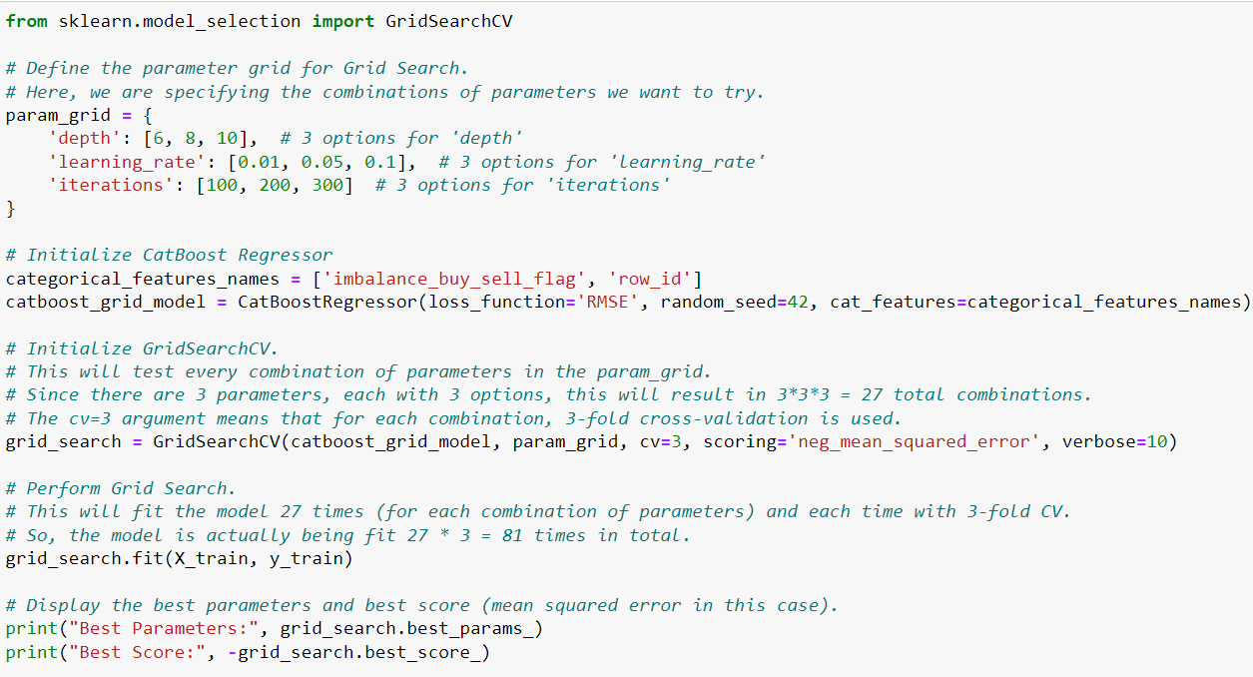
GridSearch

Slide 28
Results

Slide 29
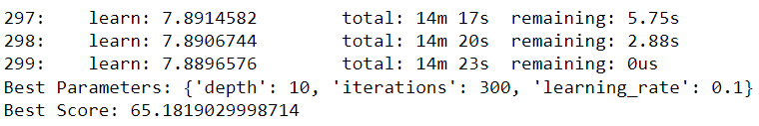
Mean Squared Error
Tuned hyperparameters and Mean Squared Error:

Slide 30
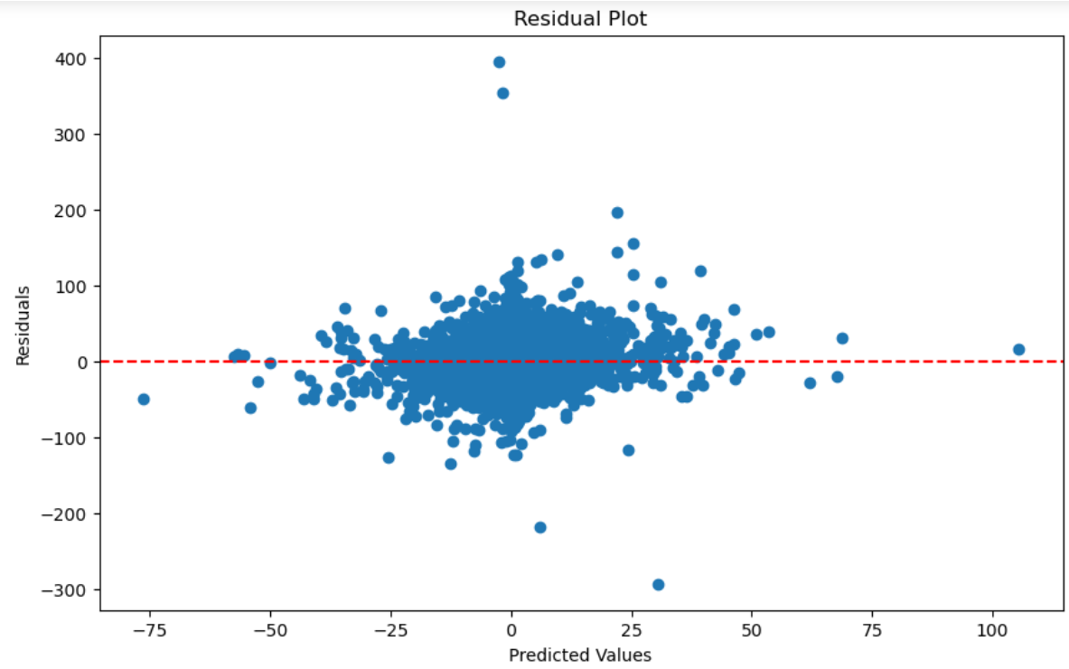
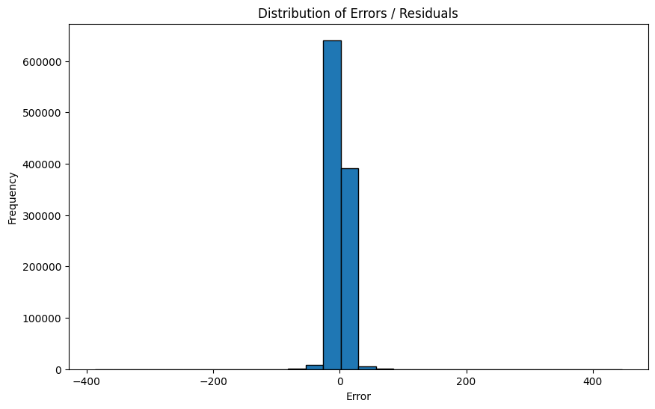
After selecting the best model, we want to analyze its performance in more detail, such as plotting residuals, analyzing errors, or studying feature importance.
1. Plotting Residuals
Residuals are the differences between the observed values and the values predicted by the model. Plotting these can help in understanding the error distribution.
2. Analyzing Errors
You can analyze the distribution of errors (residuals) to check for patterns. A well-performing model should have errors distributed randomly around zero.

Slide 31
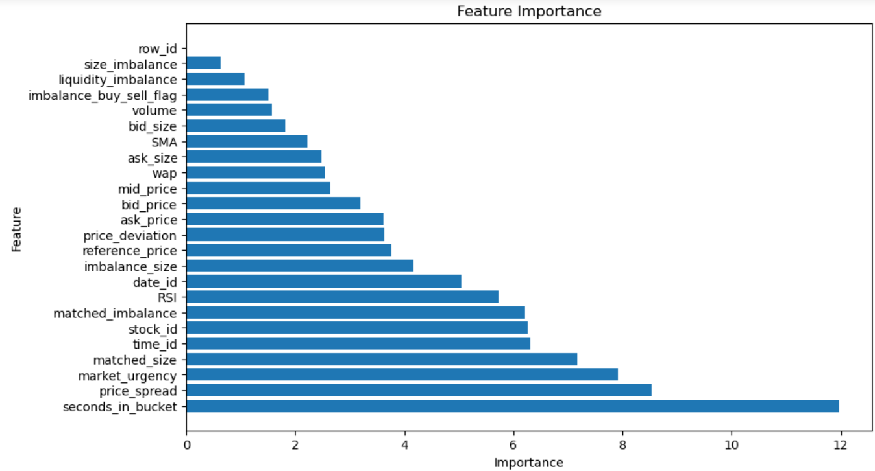
Studying Feature Importance
Feature importance gives insight into which features are most influential in predicting the target variable. This has been run again, after we have done our tuning.

Slide 32
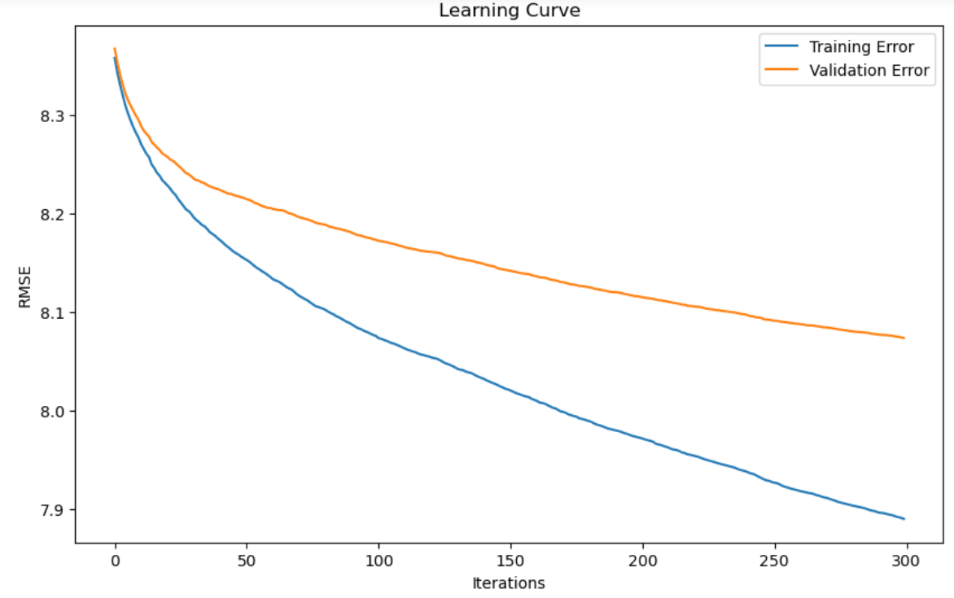
Training Vs Validation MSE
Validation error and Training error move similarly, which shows the model shouldn’t be overfitting too much.

Slide 33
Final Conclusions
Despite good work, performed nowhere as well as the other groups, who scored ~6 compared to our 65.1, which we added less of for performance
Most likely due to less hyperparameter optimization and less features engineered
Project really highlights the importance of hyperparameter optimization and engineering features

